Slide 1
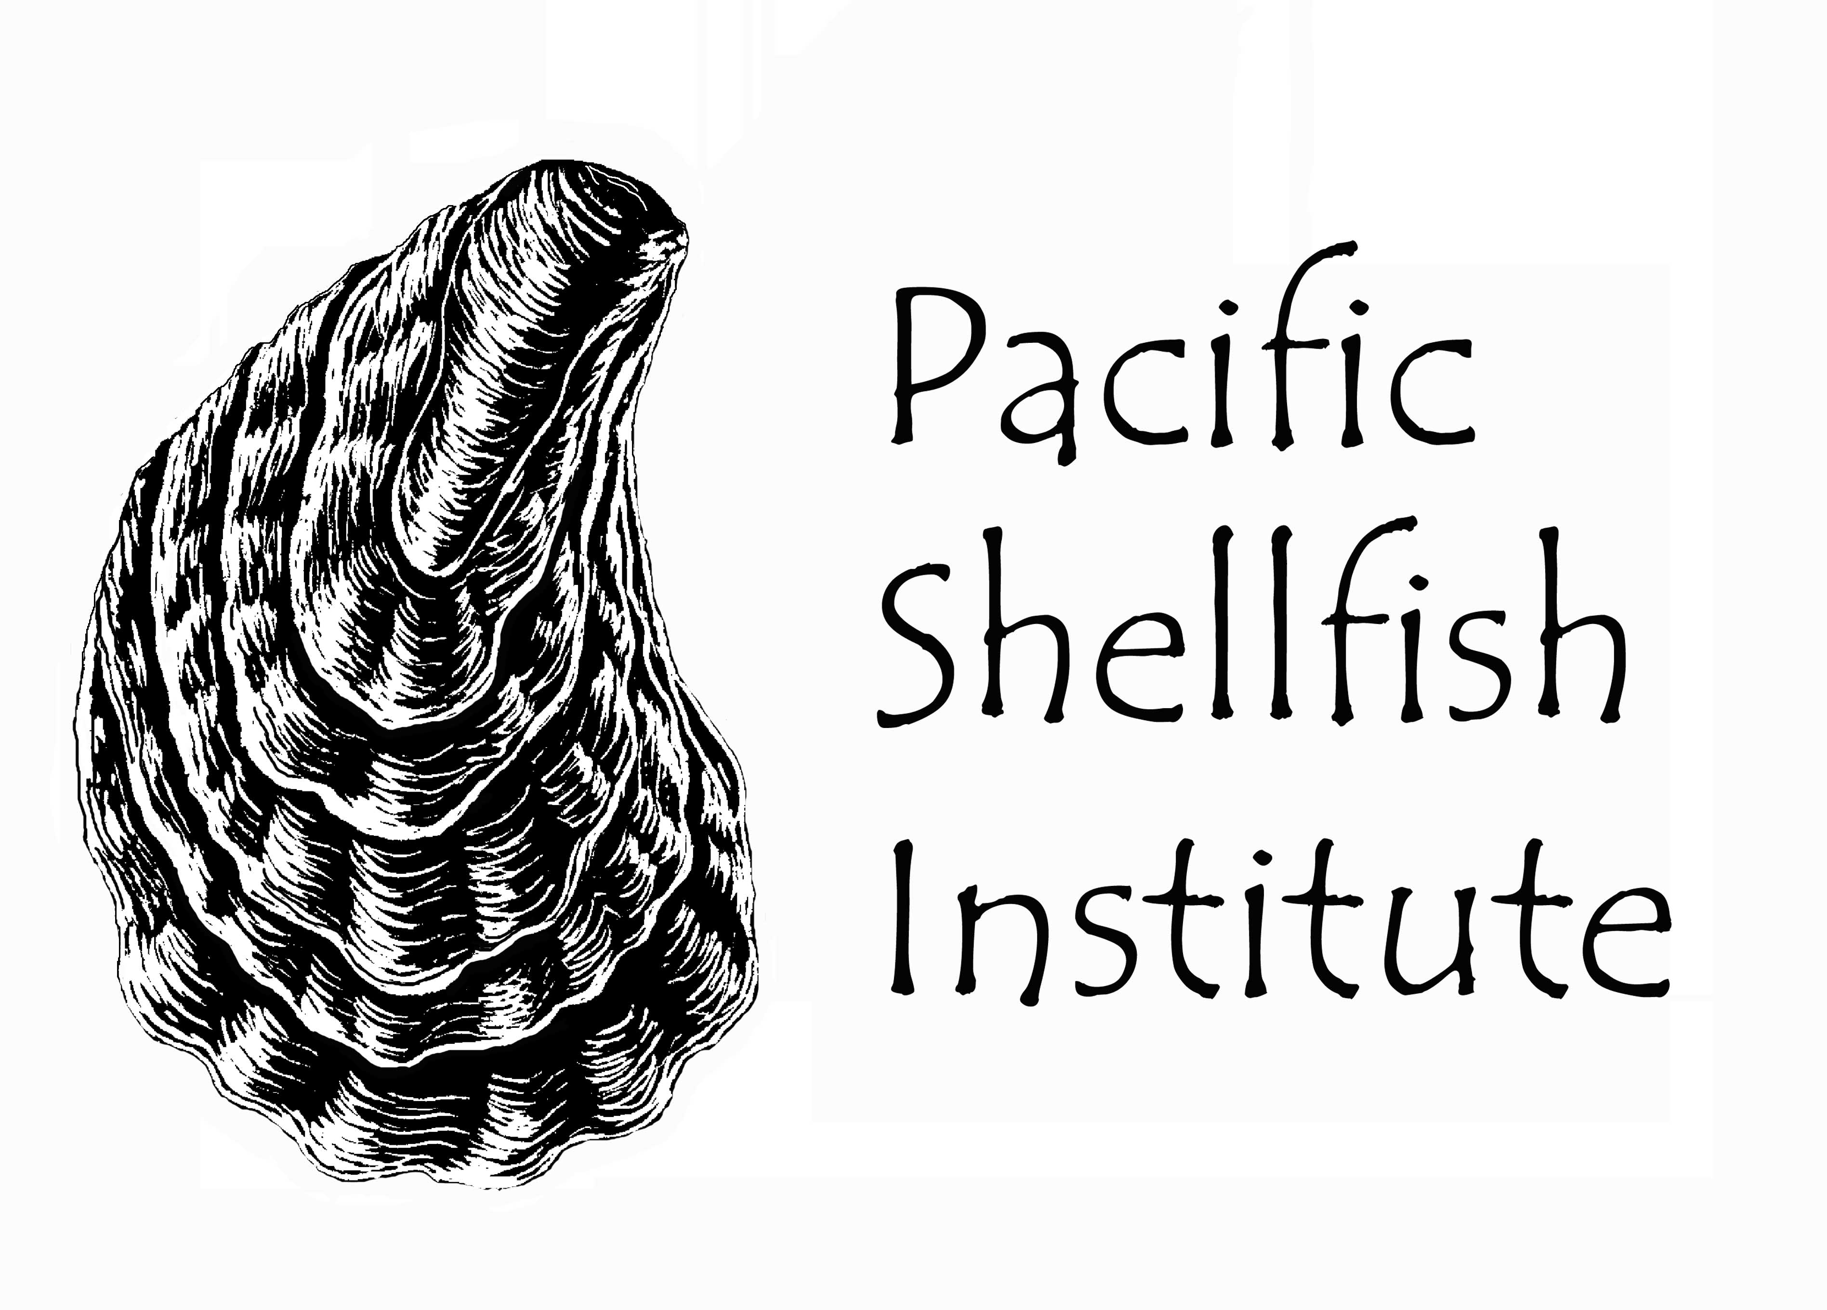
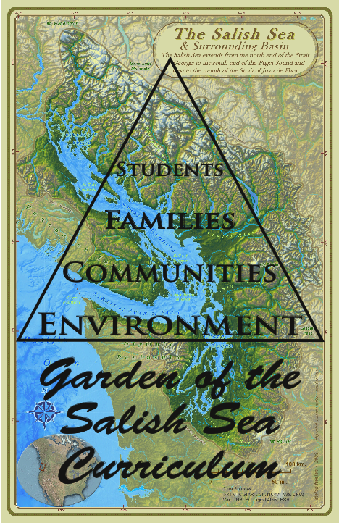
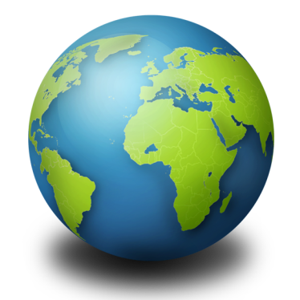
Garden of the Salish Sea
Curriculum
This product is funded through a Public Participation Grant from the Department of Ecology.
Notes:
Introduction to the name of the curriculum, Who you are, and how this presentation will answer many questions students might have. Ask students to hold questions they might have for the end of the presentation, but I might have questions for the students and will be looking for students with quietly raised hands to answer my questions.

Slide 2
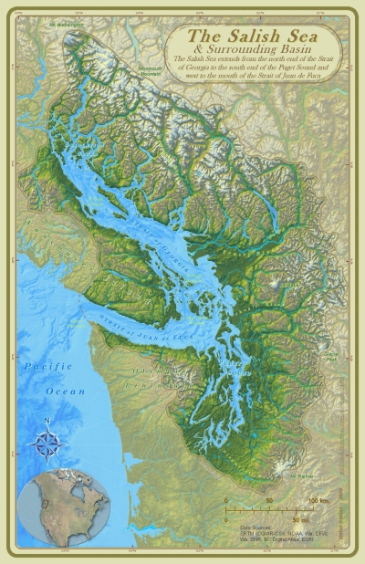
The Salish Sea &
Northwest Straits
Strait of Georgia
Strait of Juan De Fuca
Puget Sound
The Salish Sea Basin covers 7000 square miles
Notes:
Ask students what is this map of?

Slide 3
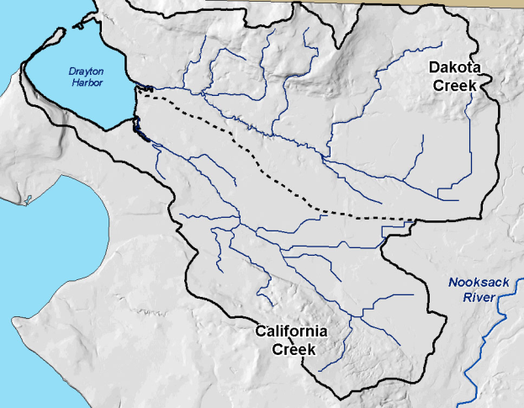

Slide 4
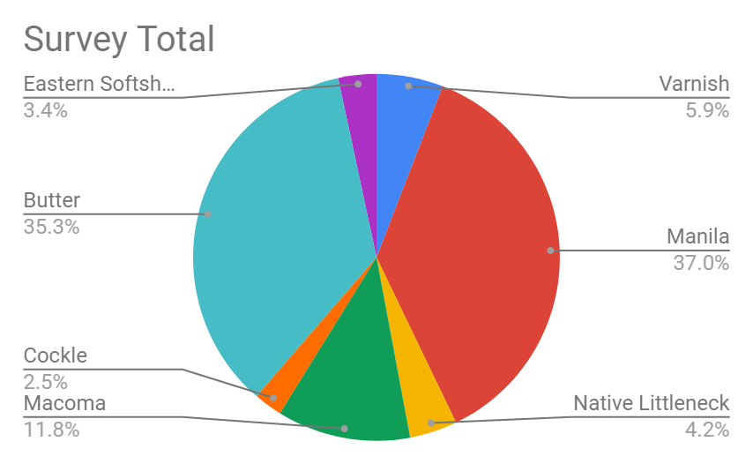
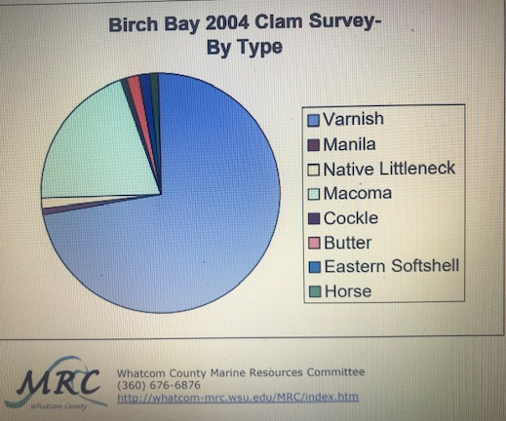
2019 transect
Total clams – 119
GSSC student clam survey data
Whatcom Marine Resource Committee, 2004

Slide 5
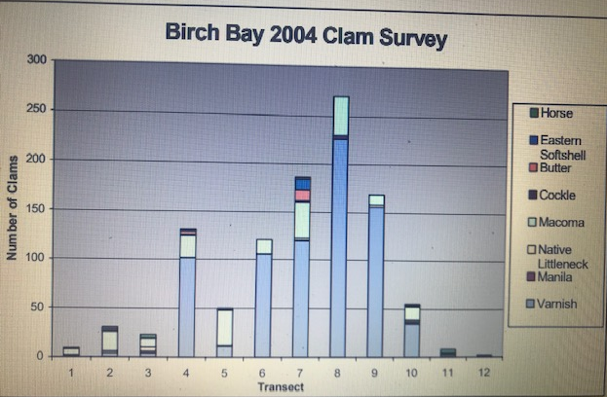
Whatcom Marine Resource Committee, 2004

Slide 6
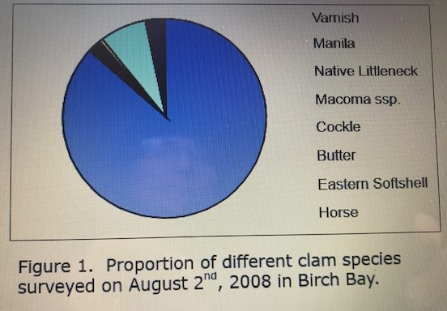
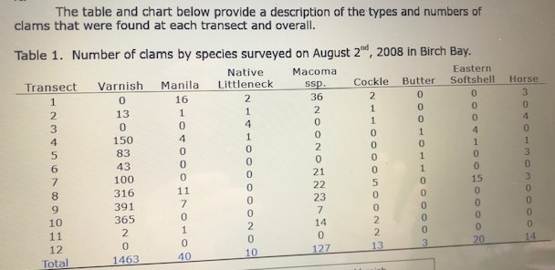
Whatcom Marine Resource Committee, 2008
Figure 1. Proportion of different clam species surveyed on August 2nd, 2008 in Birch Bay.
Birch Bay 2008 Clam Survey Results
The Birch Bay clam surveys were conducted
on August 2nd, 2008. Forty-six volunteers assisted
with the survey covering twelve transects. The
transects began just northeast of Birch Bay State
Park and were sited every ¼ mile around the Birch
Bay shoreline to just east of the Birch Bay Village
marina.
Transects ran from the upper part of the
beach where clams were first found to the water
line at the low tide (-1.8 ft). Sample holes were
situated every 100 feet along the transects, and
transects ranged in length from 1,100 ft. to 5,000
ft.
The table and chart below provide a description of the types and numbers of
clams that were found at each transect and overall.
Table

Slide 7
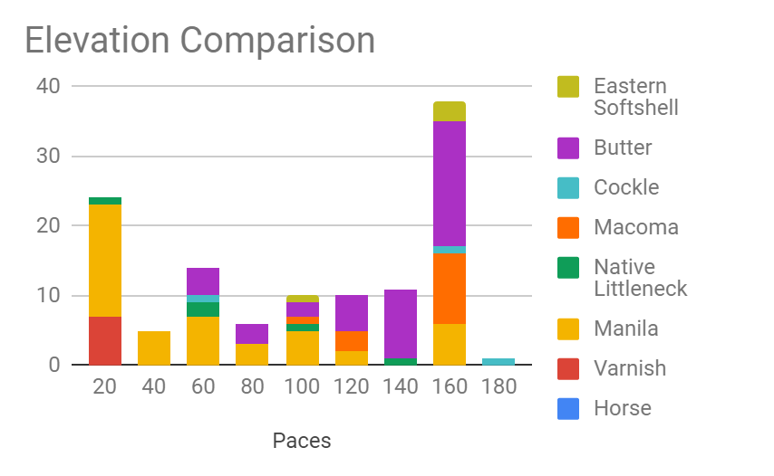
2019 Transect

Slide 9
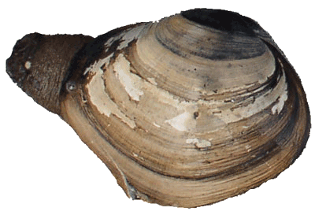
Horse Clam
Hinge is not visible
Large gape in shell for siphon

Slide 10
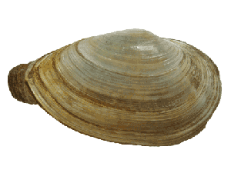
Eastern SoftShell
Hinge is not visible
Shells are not mirror images of each other
Shells do not touch each other

Slide 11
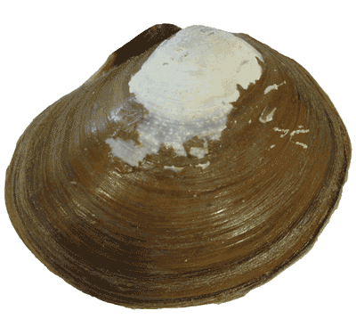
Varnish Clam
Brownish varnish coating on outside of shell

Slide 12
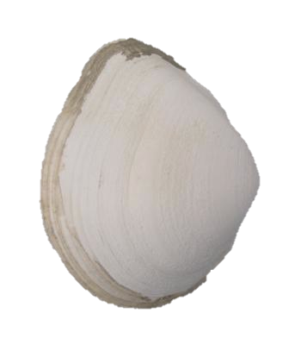
Macoma
Smooth, thin, white shell
Can have a bend in the shell – “Bent Nose”

Slide 13
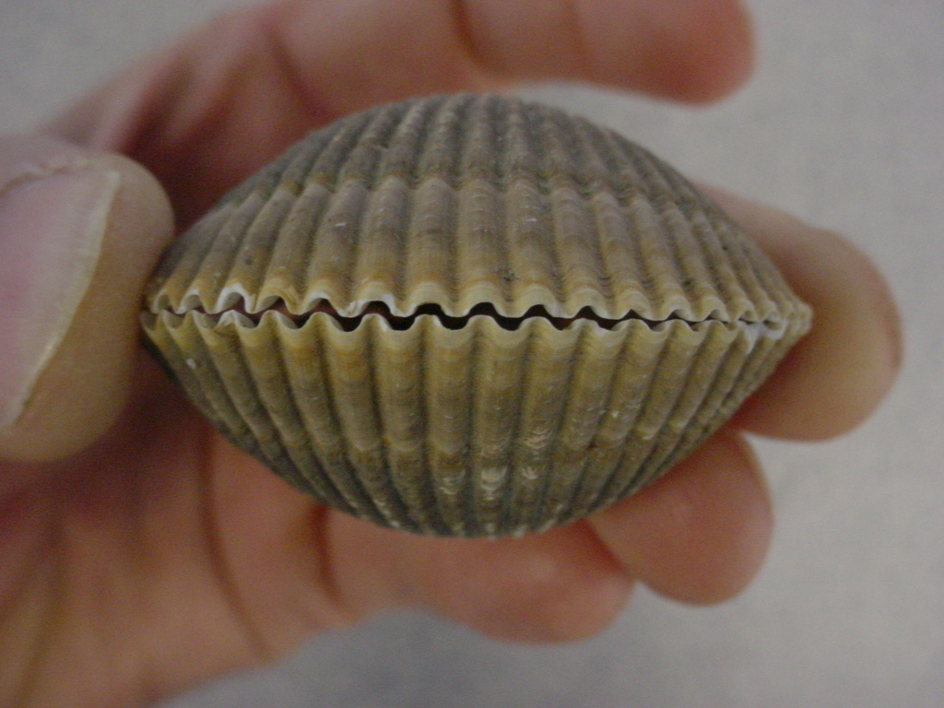
Cockle
Zig-Zag opening
Deep radiating ridges

Slide 14
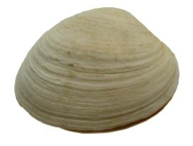
Butter Clam
Concentric Rings
Thick white/gray shell

Slide 15
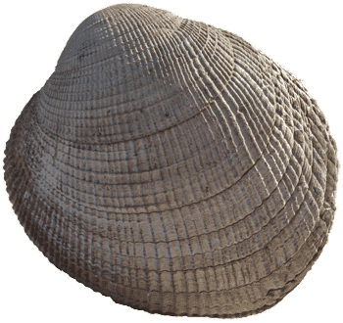
Native Littleneck
Ridges you can feel with your thumb where the two shells meet
More round than oval shell
Radiating ridges and concentric rings

Slide 16
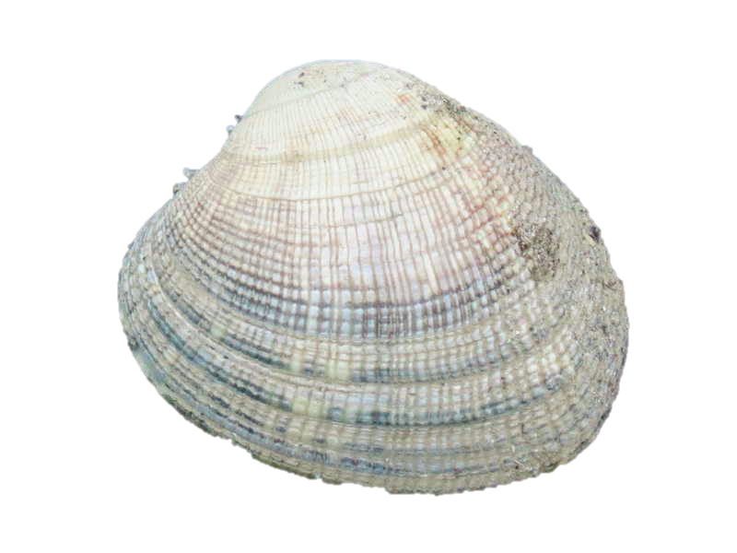
Manila Clam – Imported from Japan
Radiating ridges and concentric rings
Smooth when you rub your thumb near the hinge where the two shells meet
“Smooth Like Vanilla… Manila”
More oval than round

Slide 19
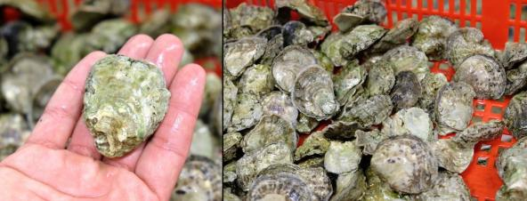
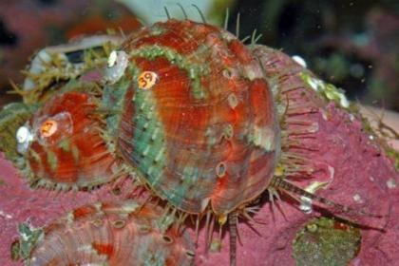
Olympia Oyster – Puget Sound’s only native oysters were nearly wiped out in the 19th century from overharvesting.
Abalone populations worldwide have been in decline due to over-harvest and habitat degradation. Pinto abalone are an endangered species in the State of Washington.

Slide 20
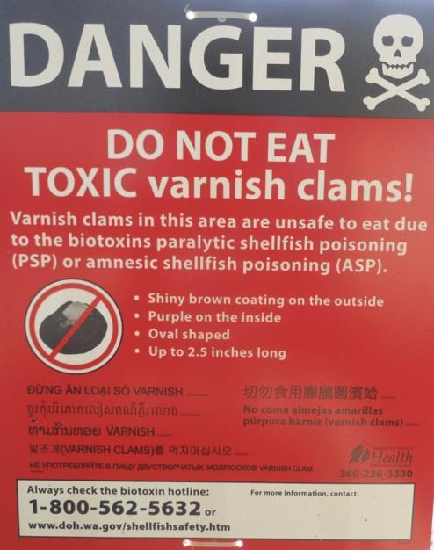
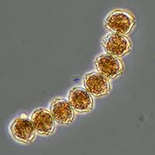
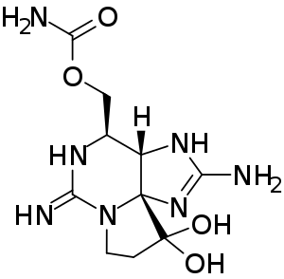
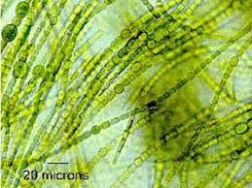
The saxitoxin molecule shown in its unionized state.
Parlalytic shellfish poisoning caused by toxic algal blooms of blue-green algae (cyanobacteria) or dinoflagellates like Alexandrium sp

Slide 21
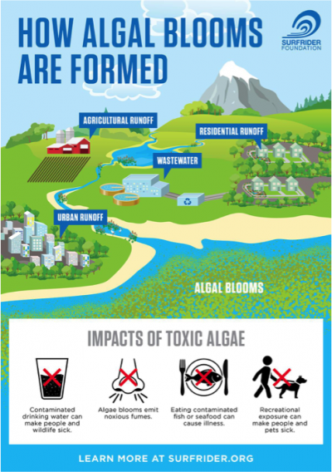
Harmful algal blooms form, when conditions allow cyanobacteria to reproduce rapidly in water with: elevated nutrient levels, high temperatures and still water.

Slide 22
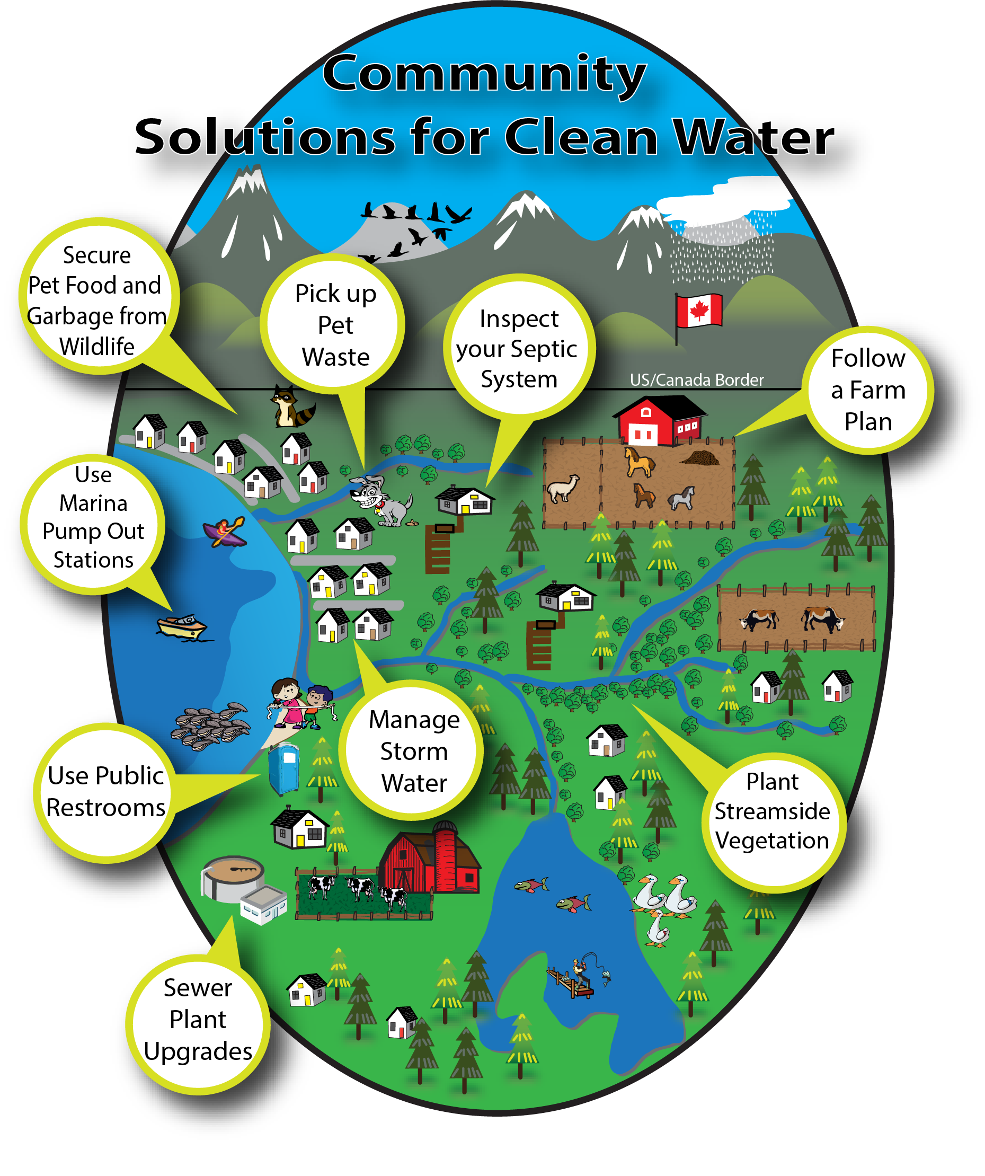

Slide 23
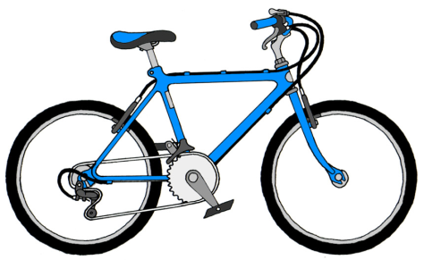
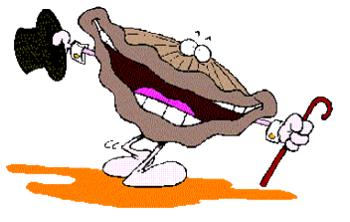
We can reduce our carbon dioxide emissions
1 mile driven in a car = about 1 pound of CO₂
My shell is nice and thick!
Notes:
We can ride a bike to school, carpool, take a bus, or walk to reduce transportation emissions

Slide 24
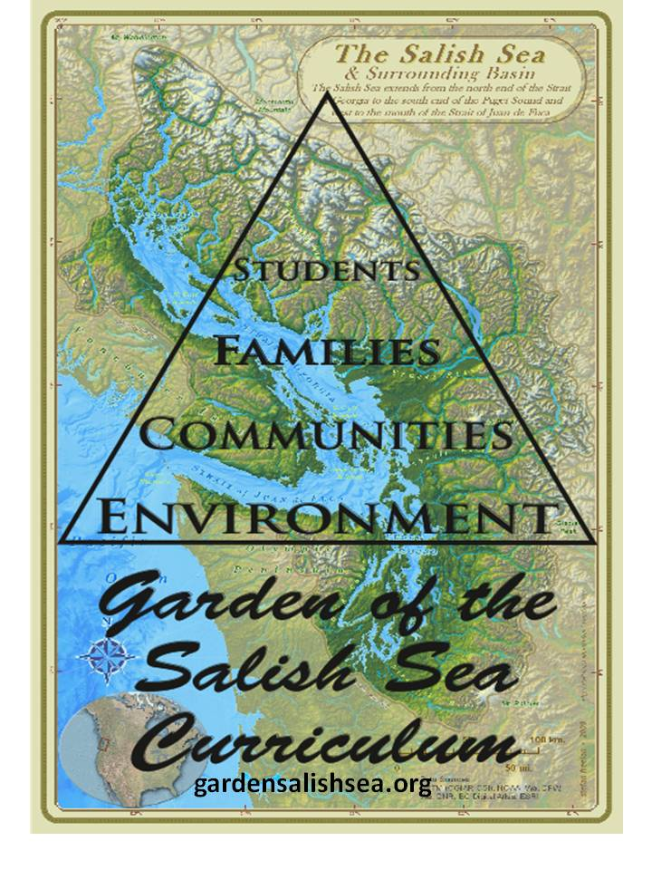
As Salish Sea Stewards, we can keep our waters healthy which will keep us healthy!
Lets take this Challenge together!

