Slide 1
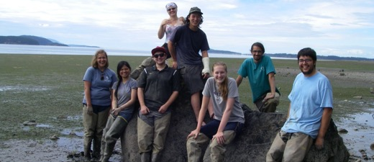
Mesocosm studies provide a link between models and observations of metabolic and tidally driven pCO₂ variability in a large eelgrass meadow
Brooke Love, Tyler Tran, Cale Miller, Sylvia Yang
Western Washington University
Shannon Point Marine Center
Hillary Thalmann
Katey Williams
Lynne Nowak
Mike Adamczyk
Jayshen Blows
Abby Ernest-Beck
Eric Wilson
Darby Finnegan
Brooke McIntyre
Cristina Villalobos.
Colleen O’Brien
Stephen Sulkin
Gene Mckeen
Nate Schwarck
Natasha Borgen
Heath Bohlmann
Nicole Burnett
Steve Sulkin

Slide 2
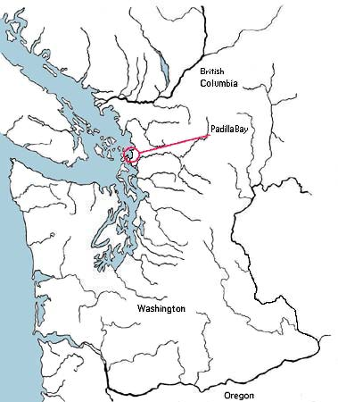
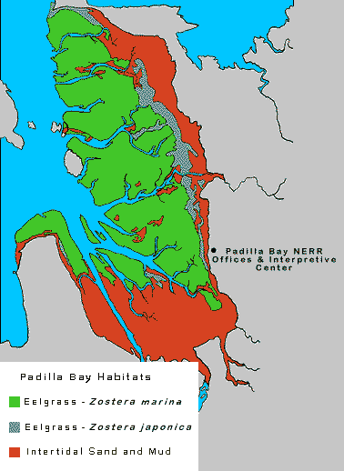
Eelgrass Zostera marina
Eelgrass Zostera japonica
Intertidal Sand and Mud
Location of Padilla Bay (www.padillabay.gov)

Slide 3
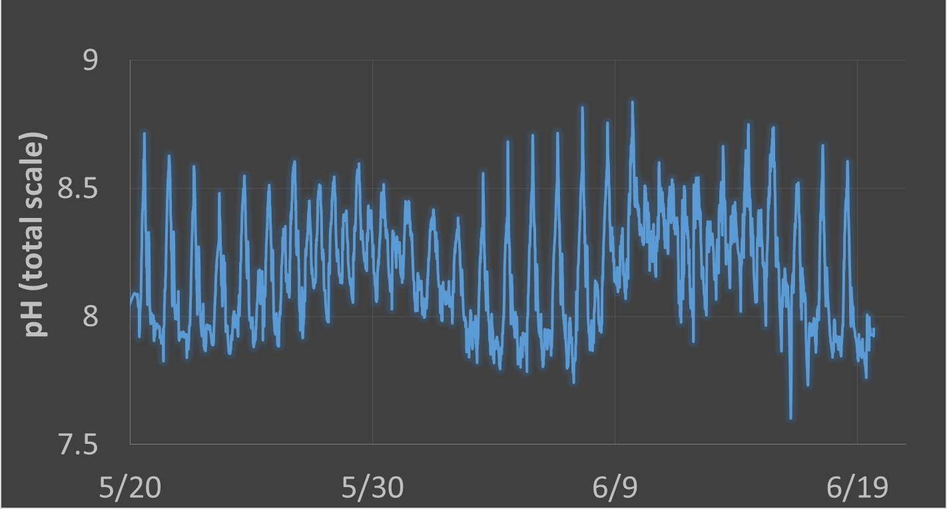
Spring
Neap

Slide 4
Observations
Light
Species
Biomass
Temperature
Water depth
Residence time
Source water chemistry
Resulting shifts in ambient conditions
Predictions
Can a given meadow
Provide refuge or remediation?

Slide 5
How can mesocosms help accurately predict how eelgrass meadows will effect local carbonate chemistry?
Does carbon uptake respond to ambient total carbon?
How does carbon uptake scale with eelgrass density?
How does the interaction of light and eelgrass density influence carbon uptake?

Slide 6
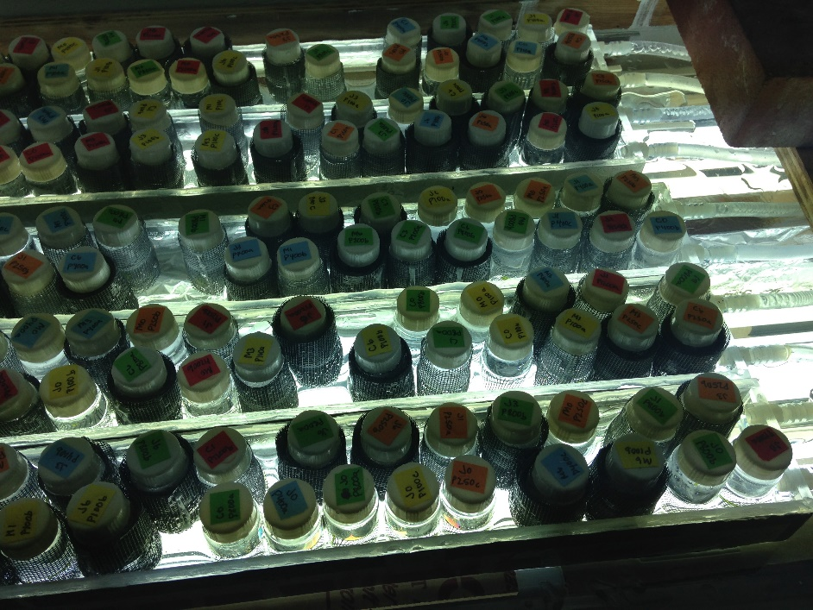
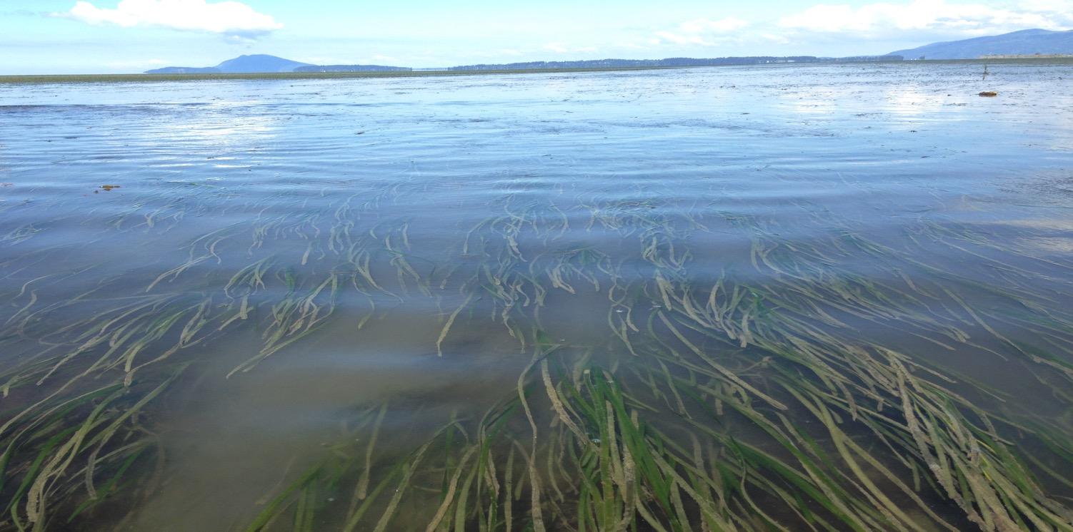
Does carbon uptake respond to ambient total carbon?
Long term : yes
Instantaneous : ?

Slide 7
Maximum photosynthetic rate of Z. marina does not respond to total carbon
on short time scales
(based on leaf clippings)
Z. japonica
Z. marina
Miller et al. 2017

Slide 8
Need whole plant incubations to address these questions.
Does carbon uptake respond to ambient total carbon?
How does carbon uptake scale with eelgrass density?
How does the interaction of light and eelgrass density influence carbon uptake?

Slide 9
Experimental Factors
Light
Saturating Light
Subsaturating Light
Dark
Leaf Area Index
(LAI)
Initial pCO₂
Ambient pCO₂
Enriched pCO₂

Slide 10
After
Jokiel

Slide 11
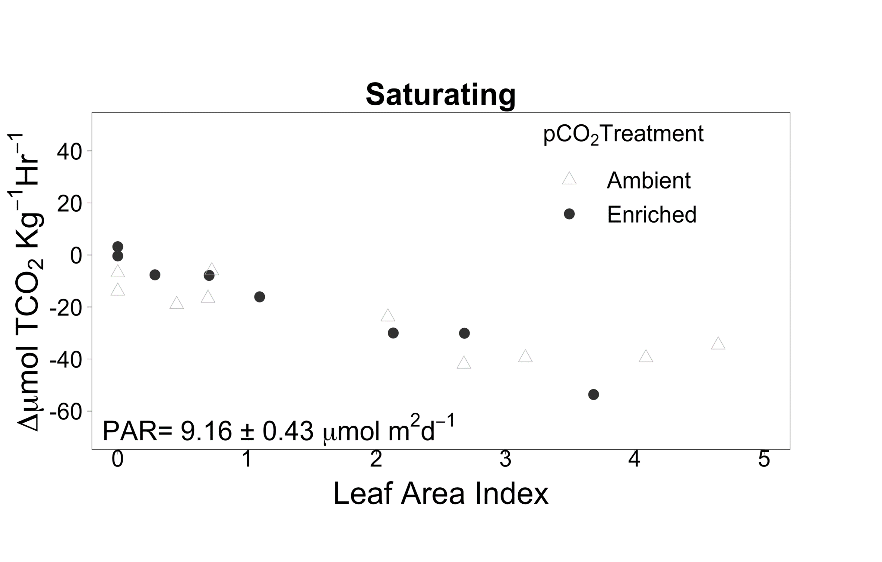
How does carbon uptake scale with eelgrass density?
Saturating Light
-

Slide 12
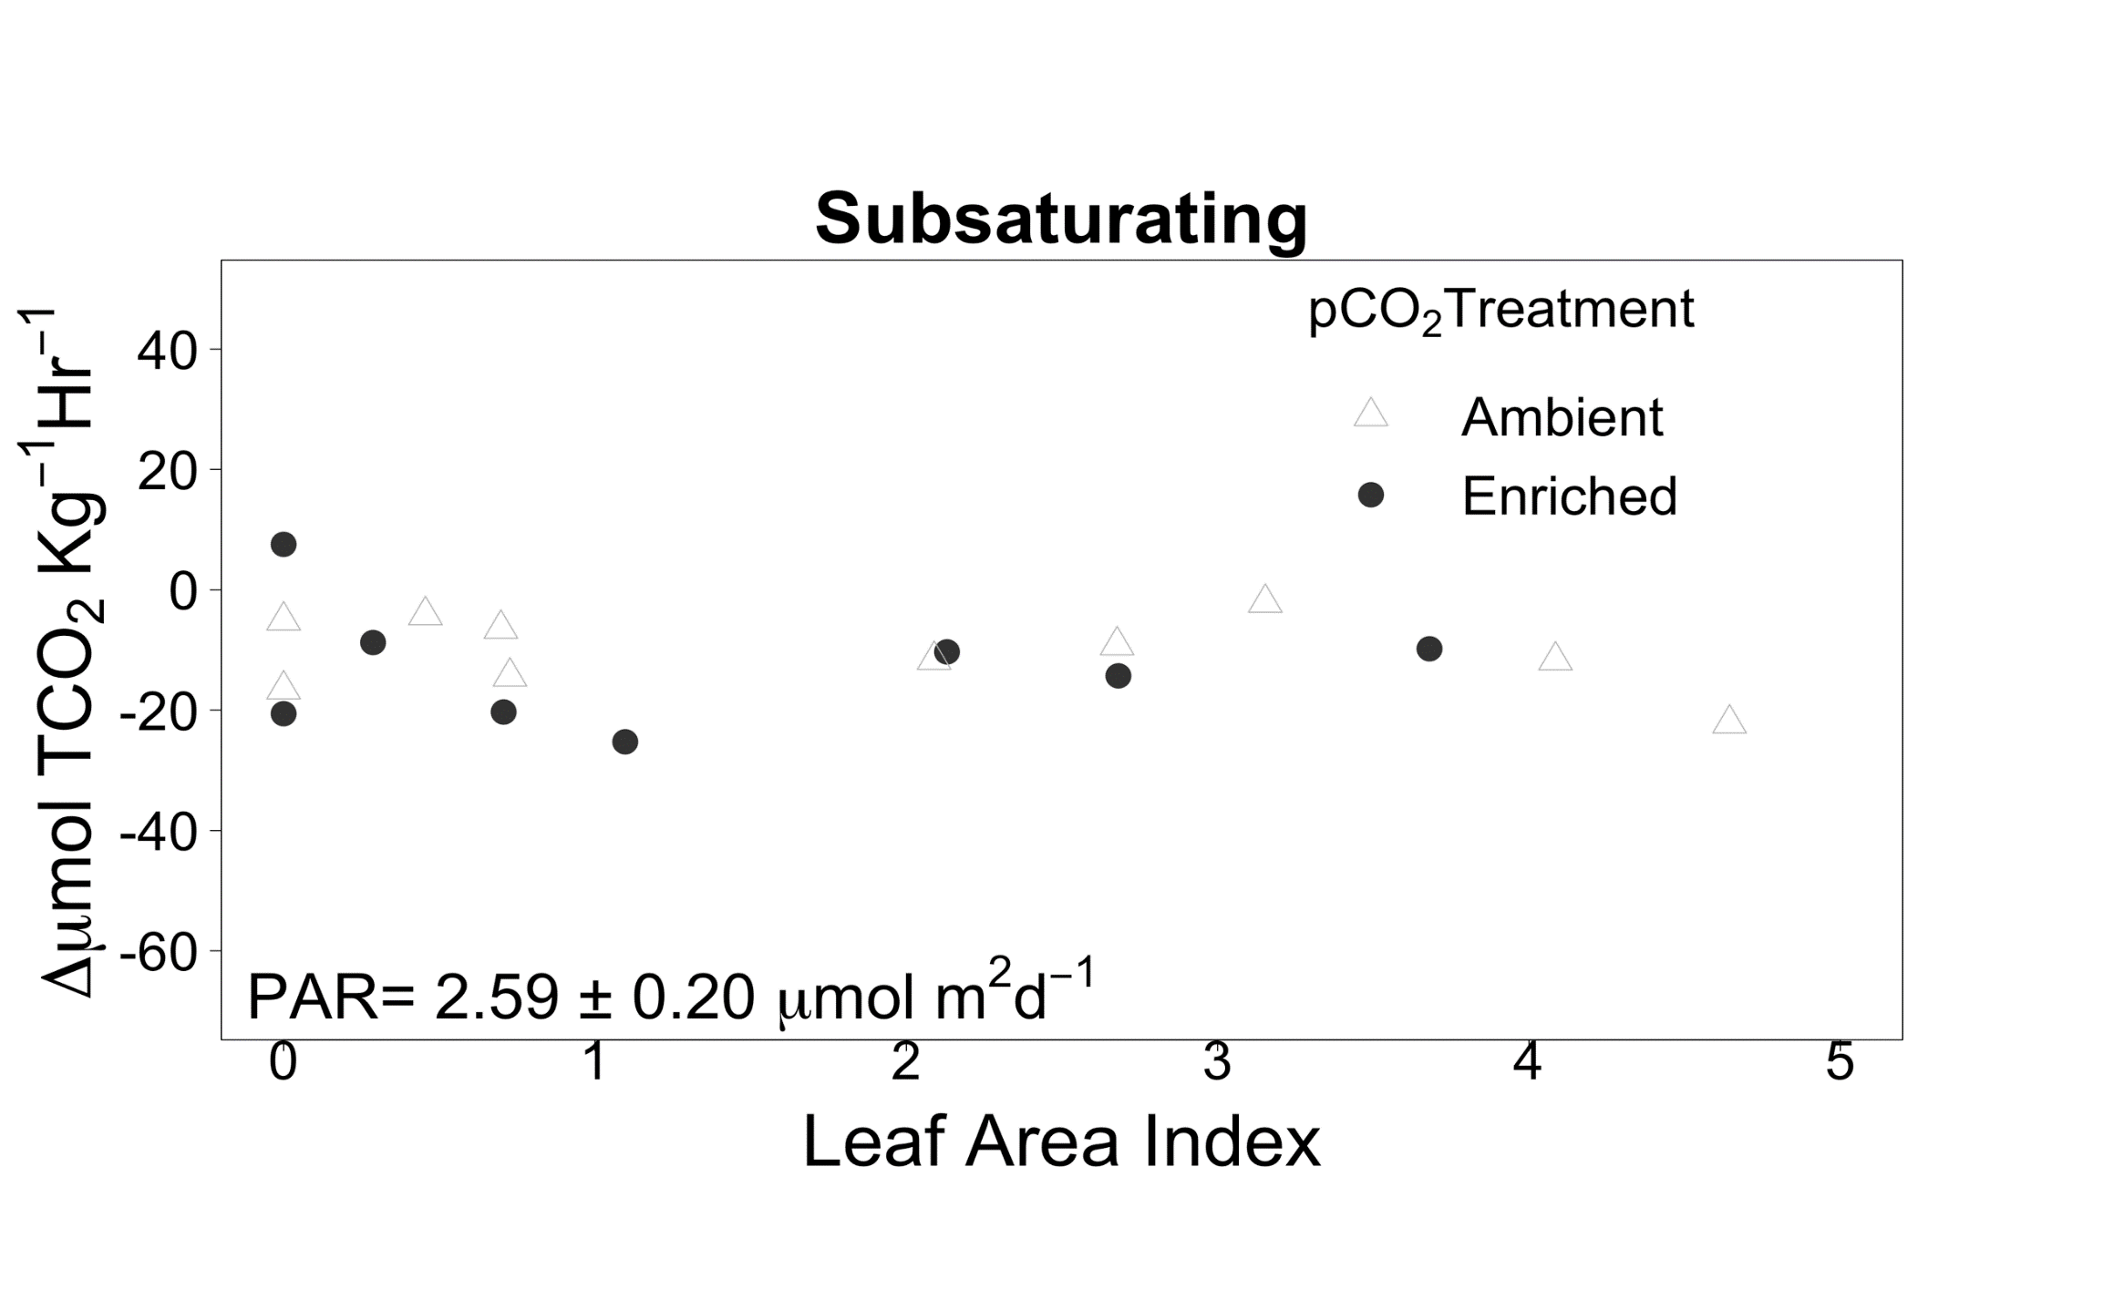
How does the interaction of light and eelgrass density influence carbon uptake?
Subsaturating Light
-

Slide 13
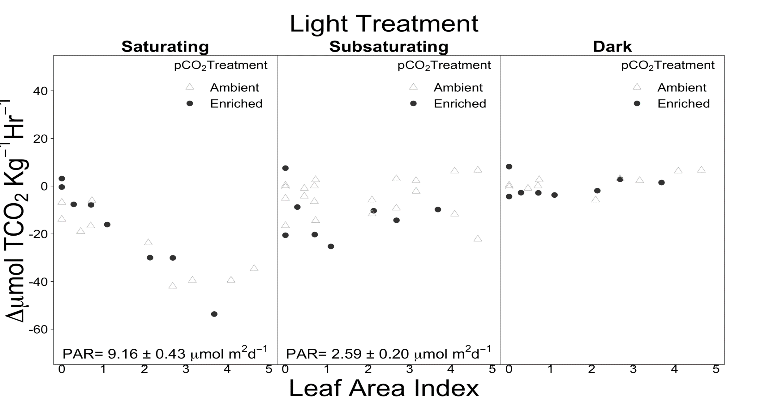
Saturating Light
Subsaturating Light
Dark

Slide 14
Does carbon uptake respond to ambient total carbon?
No
Rates estimated with clippings and
whole plants agree
Whole plant
Leaf clippings
Miller et al. 2017

Slide 15
ΔpH h⁻¹
Water depth (m)

Slide 16
In Summary
Does carbon uptake respond to ambient total carbon?
No, not enough to affect meadows as mediators of carbon.
How does carbon uptake scale with eelgrass density?
Linearly within observed density range when light is high.
How does the interaction of light and density influence carbon uptake?
Self shading effects appear when light is low.
Can a given meadow provide OA refuge or remediation?
Only with favorable water depth, eelgrass density light and residence time

