Slide 1
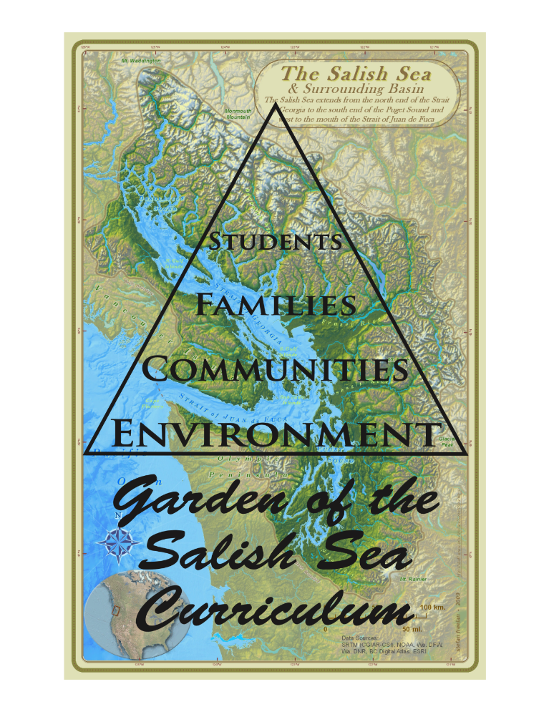
All rights reserved © Garden of the Salish Sea Curriculum 2018

Slide 2
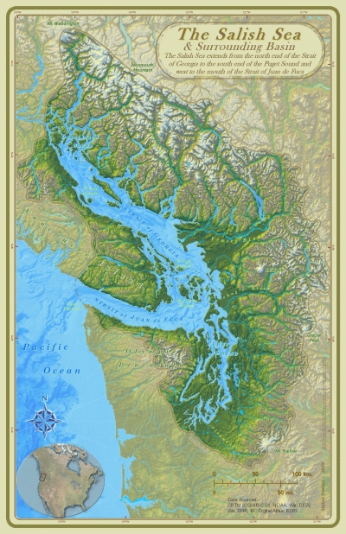
The Salish Sea &
Northwest Straits
Strait of Georgia
Strait of Juan De Fuca
Puget Sound
The Salish Sea Basin covers 7000 square miles
Notes:
Ask students what is this map of?

Slide 3
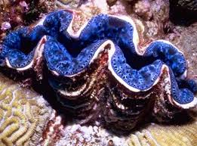
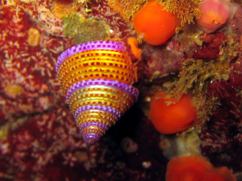
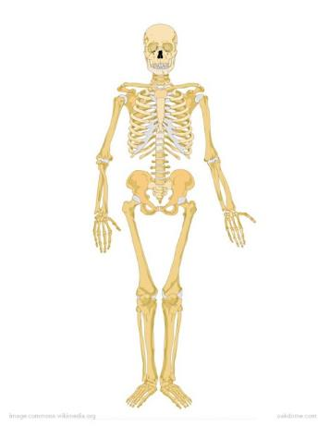
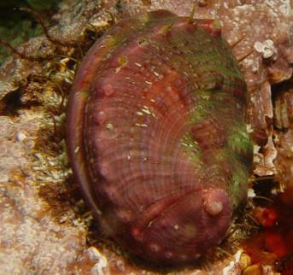
Shellfish are Mollusks
Do they have backbones?
Giant Clam
Shellfish have EXOSKELETONS
Pinto Abalone
Notes:
Shellfish are invertebrates, unlike us because we have a spine therefore are vertebrates

Slide 4
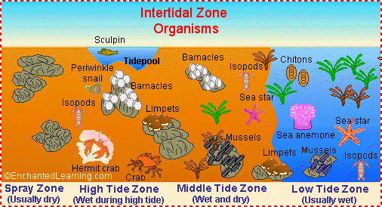
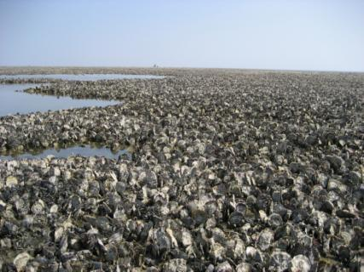
Oysters live in the intertidal zone and create oyster reefs
Oysters are reef builders where communities of other organisms grow. This one’s in Germany

Slide 5
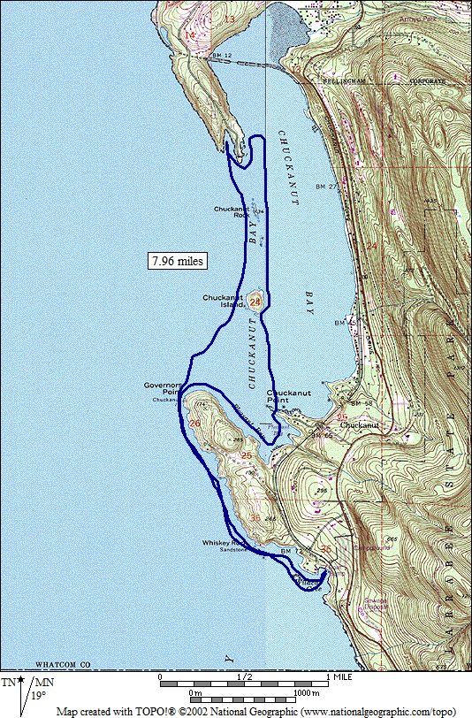
Shellfish around the world,
Including within the Salish Sea!

Slide 6
Classification

Slide 7
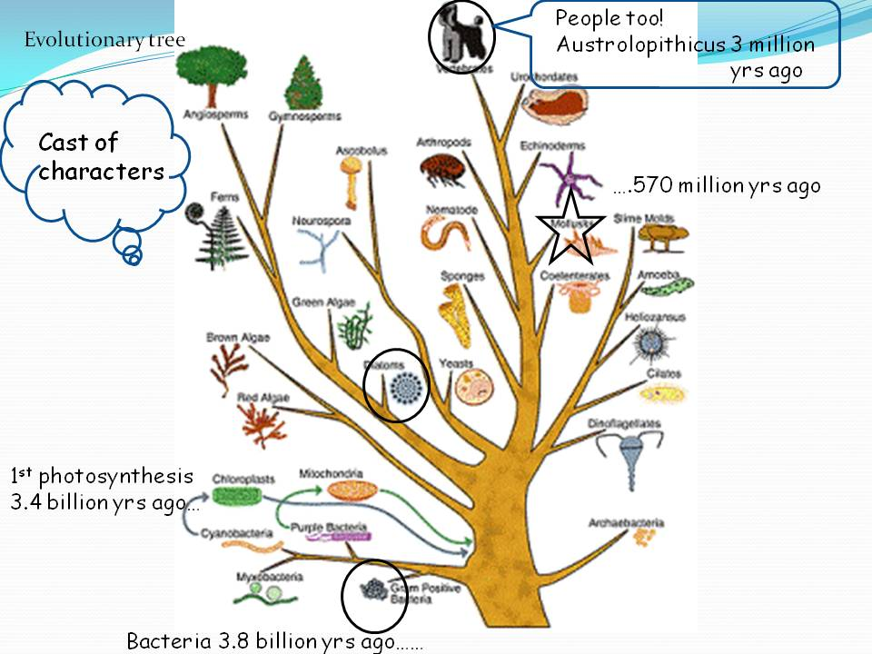

Slide 8
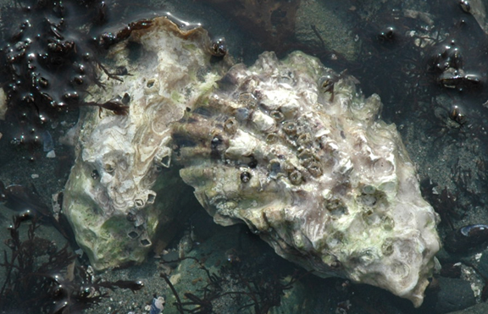
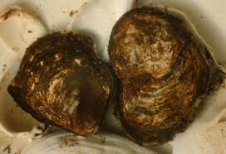
Pacific Oyster (Crassostrea gigas)
Introduced from Japan
Olympia Oyster
(Ostrea lurida)
Only native oyster to the Puget Sound and its populations are threatened

Slide 9
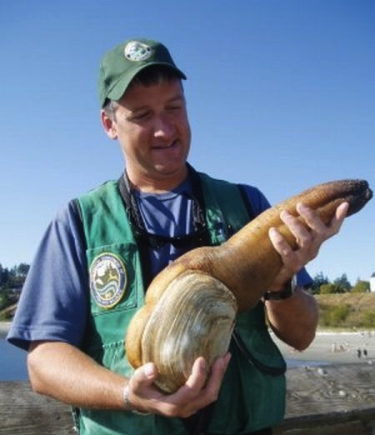
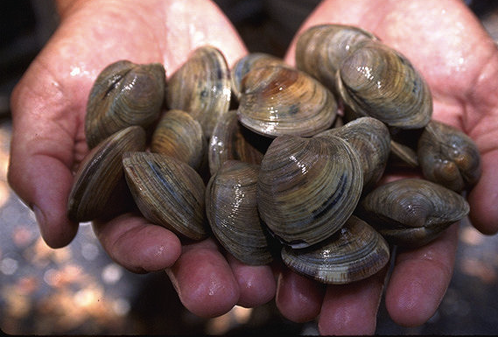
Manila clams, Venerupis philippinarum, were introduced to the Salish Sea from Japan.
Geoduck, Panopea generosa is the largest burrowing clam, can reach up to 8 pounds and live 150 years.

Slide 10
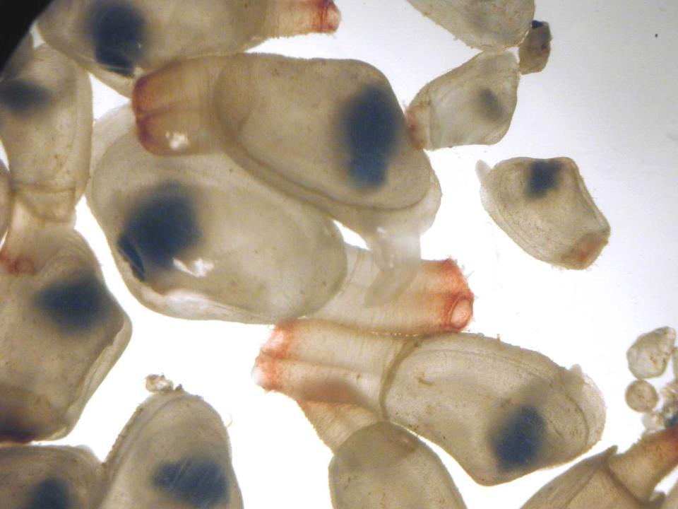

Slide 12
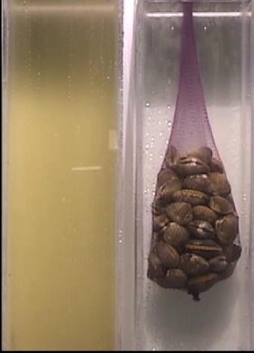
Shellfish are filter feeders, they breath, eat and clean the water all at the same time!
Each shellfish can filter 65 gallons a day!
Photo credit: PCSGA

Slide 13
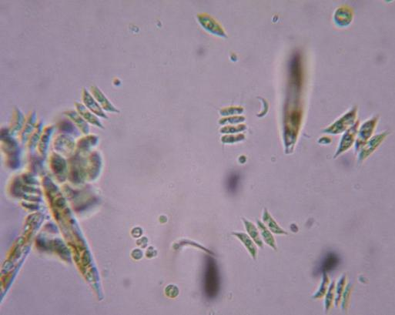
Shellfish play an important role in the food web
They eat phytoplankton
Notes:
Plankton is Greek for drifter – phyto =plants, zoo = animals

Slide 14
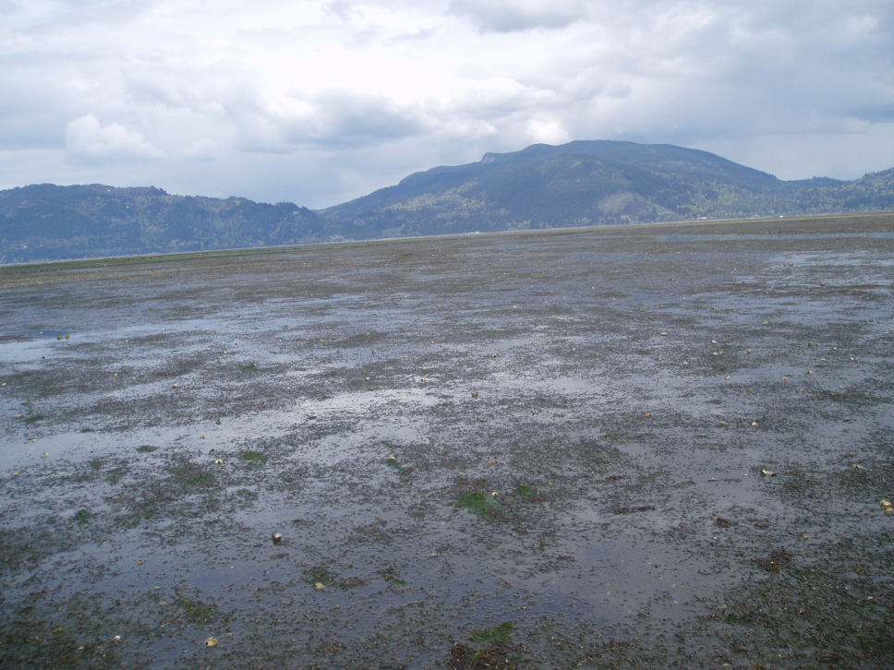
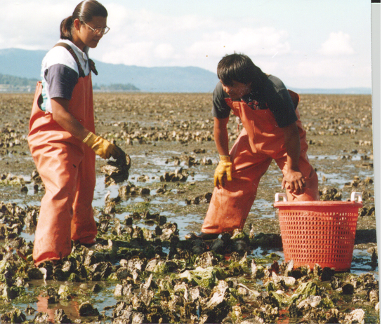
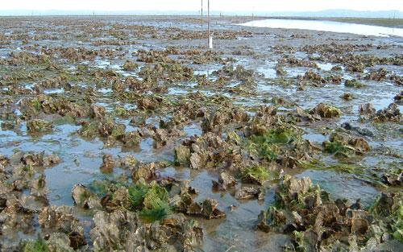
INTERTIDAL OYSTER CULTURE
Traditional on bottom culture
Typical intertidal oyster ground

Slide 15
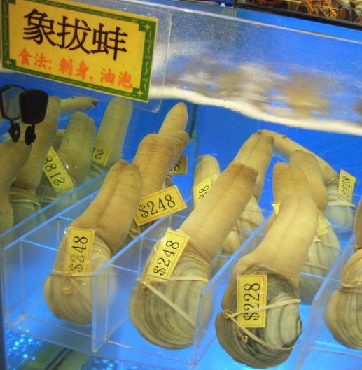
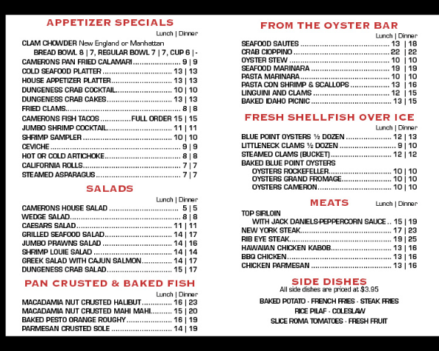
Shellfish in the Pacific Northwest provide an estimated $207 million each year in ecosystem services as well as sales and provides over 3,200 jobs. (NOAA 2012)
PACIFIC COAST SHELLFISH PRODUCTION
WA Shellfish Revenue → $ 100,560,000 All PNW Shellfish Revenue → $ 117,430,000

Slide 16
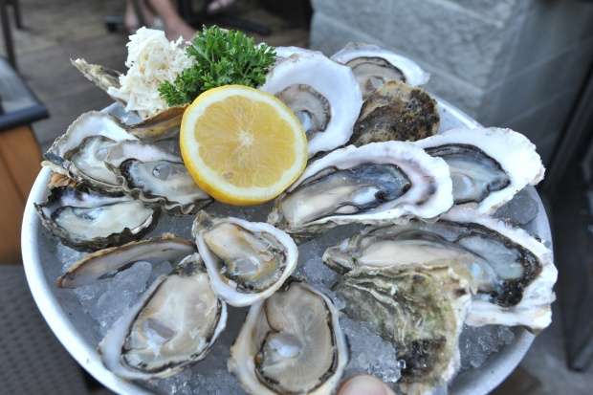
Shellfish are Nutritious and Delicious!
High in Protein
Low in fat
Omega -3 fatty acids
“Brain Food”
Minerals such as iron and zinc to support healthy blood and immune system
*Some people are allergic to shellfish and should not consume any food containing even a small amount

Slide 17
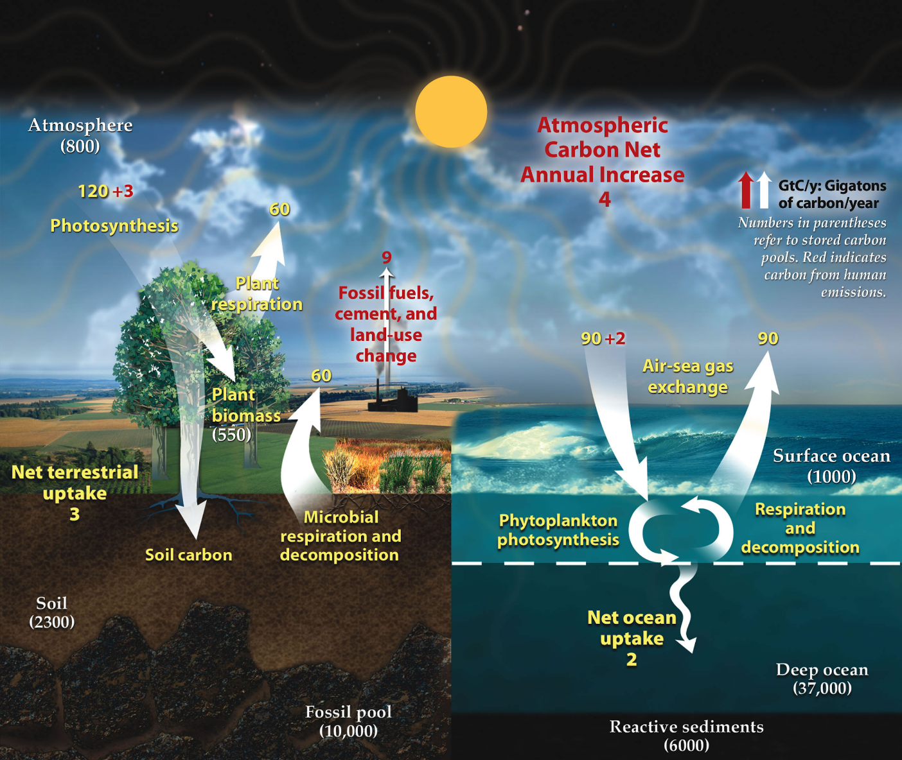
The Carbon Cycle

Slide 18
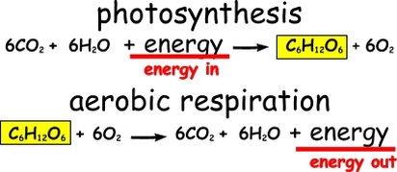
What do each of these equations represent?

Slide 19
Carbon dioxide is making the ocean more acidic…
All this CO₂ in the water makes my shell thin!

Slide 20
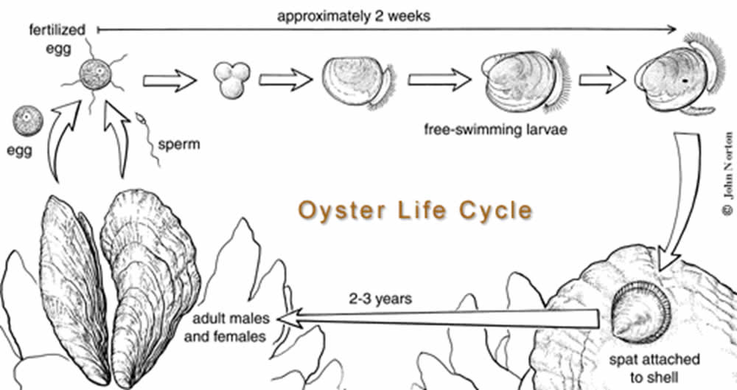
Shellfish Life Cycle
If seawater is too acidic, free-swimming larvae (velligers) cannot attach and become adults. (Seawater pH ranges from 7.5 to 8.4.)
Notes:
I think the lesson makes a lot of sense without this, because the focus is OA. Maybe it should go in the intro.

Slide 22
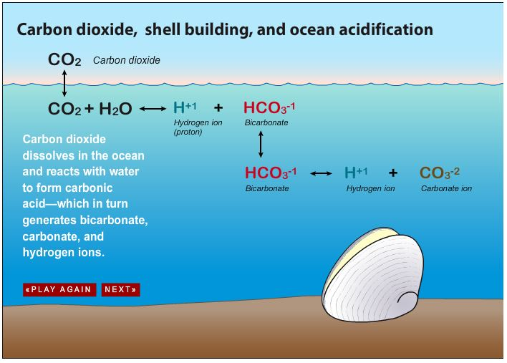
Ca⁺⁺ ₊ CO₃⁻⁻ Ca CO₃
Calcium ion + Carbonate ion Calcium carbonate

Slide 23
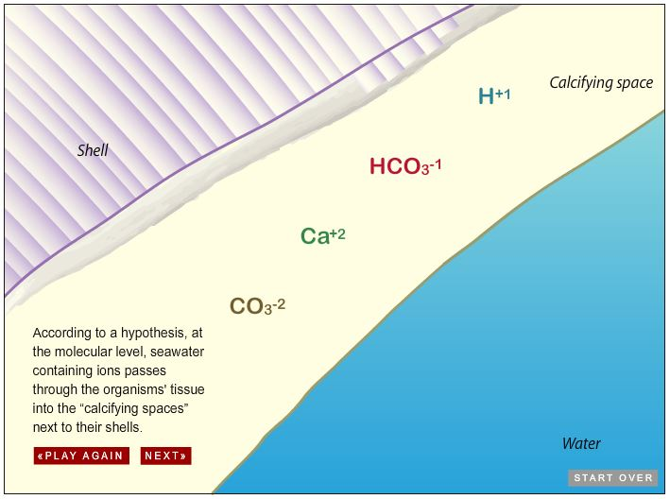

Slide 24
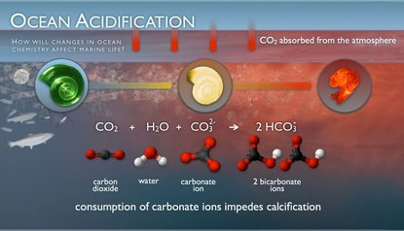
Pteropod - Sea Butterfly,Sea snail, a gastropod, base of marine food web.

Slide 25
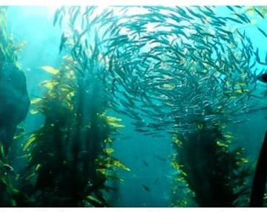
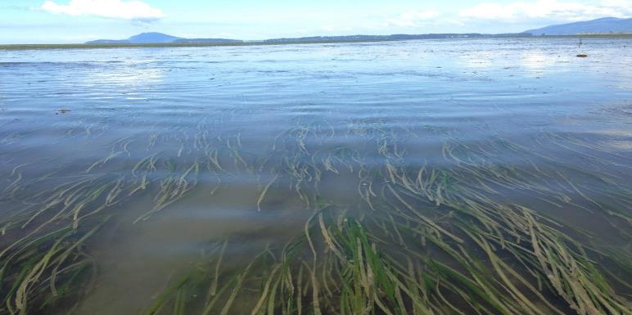
Kelp, seaweed and seagrass ecosystems sequester carbon.
That’s a carbon sink!

Slide 26
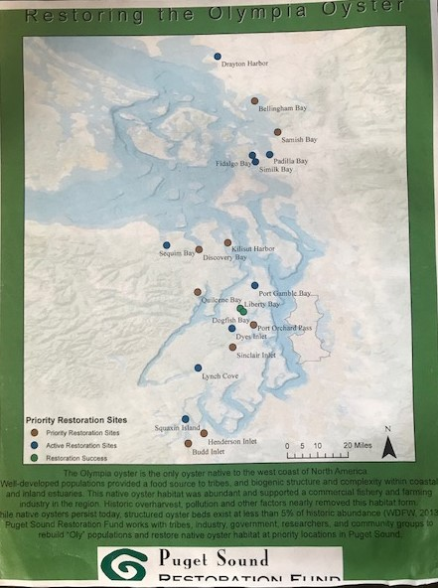
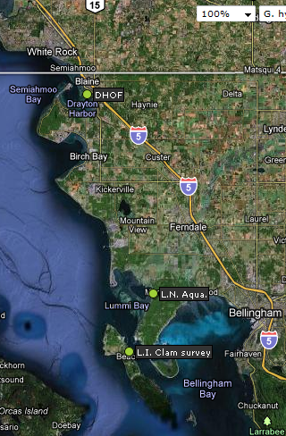
Marine resources are close to home:
Local Olympia Oyster restoration

Slide 27
Next:
You have 15 minutes to visit the three stations and answer the questions in your science notebook.

Slide 28
Next:
You have 20 minutes to visit the stations and answer the questions in your science notebook.
Stations include: Plankton, geoduck, diatoms, kelp, and local shellfish ID.

Slide 29
Next:
You have 15 minutes to work in groups to dissect oysters.
In your notebook:
Draw and label a dissected oyster
Include a detailed drawing of gills or tentacles and explain the function.

Slide 30
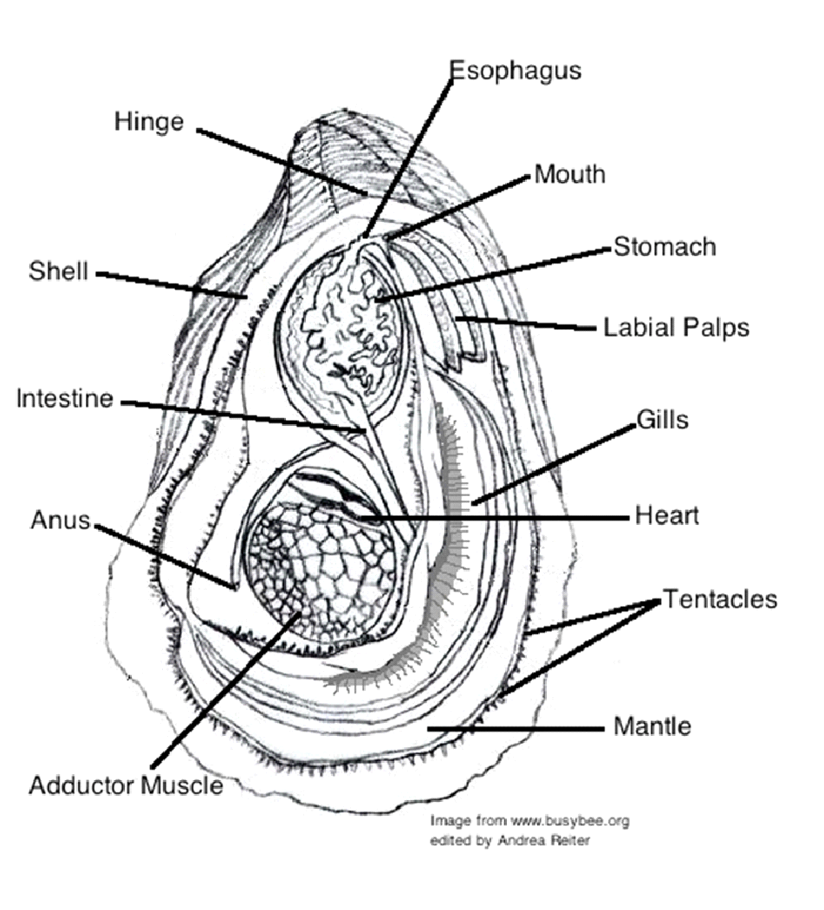
Oyster Anatomy

Slide 31
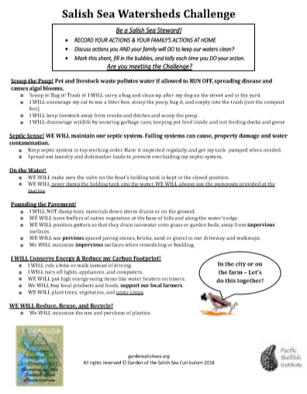
As stewards of the Salish Sea, we can keep this water healthy which will keep us healthy!

Slide 32
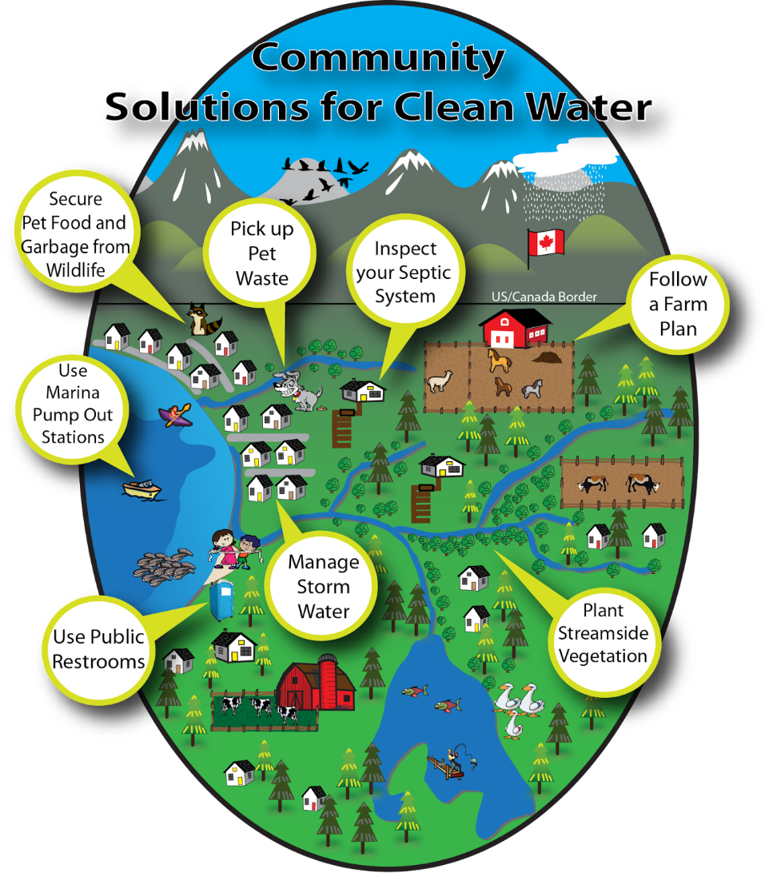

Slide 33
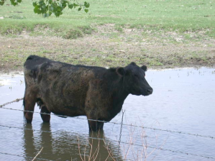
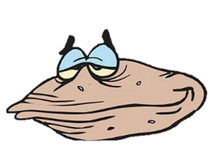
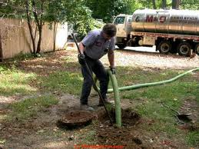
Bacteria from humans and their pets’ poop is getting into the water…
There can be 23 million bacteria per gram of pet waste

Slide 34
We can reduce our carbon dioxide emissions
1 mile driven in a car = about 1 pound of CO₂
My shell is nice and thick!
Notes:
We can ride a bike to school, carpool, take a bus, or walk to reduce transportation emissions

Slide 35
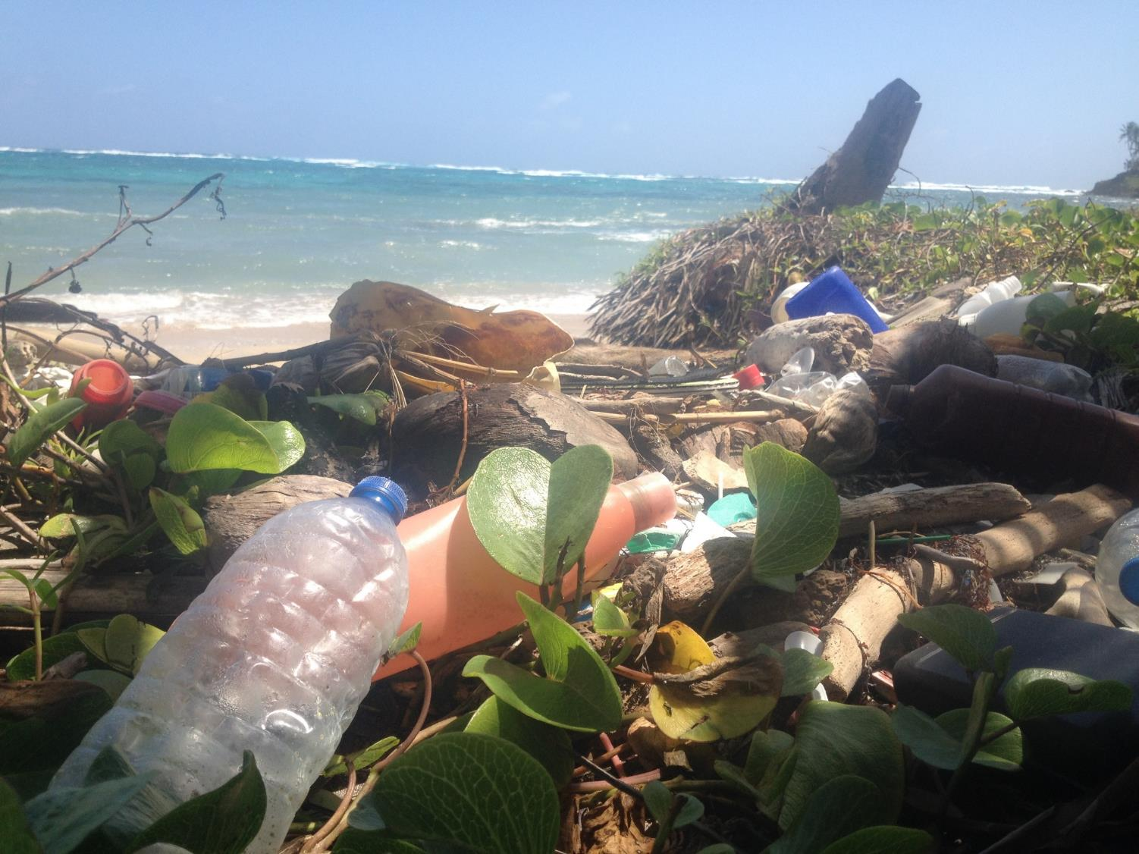
Minimize Plastics – REDUCE-reuse-recycle

Slide 36
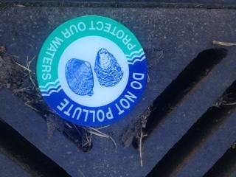

Slide 37
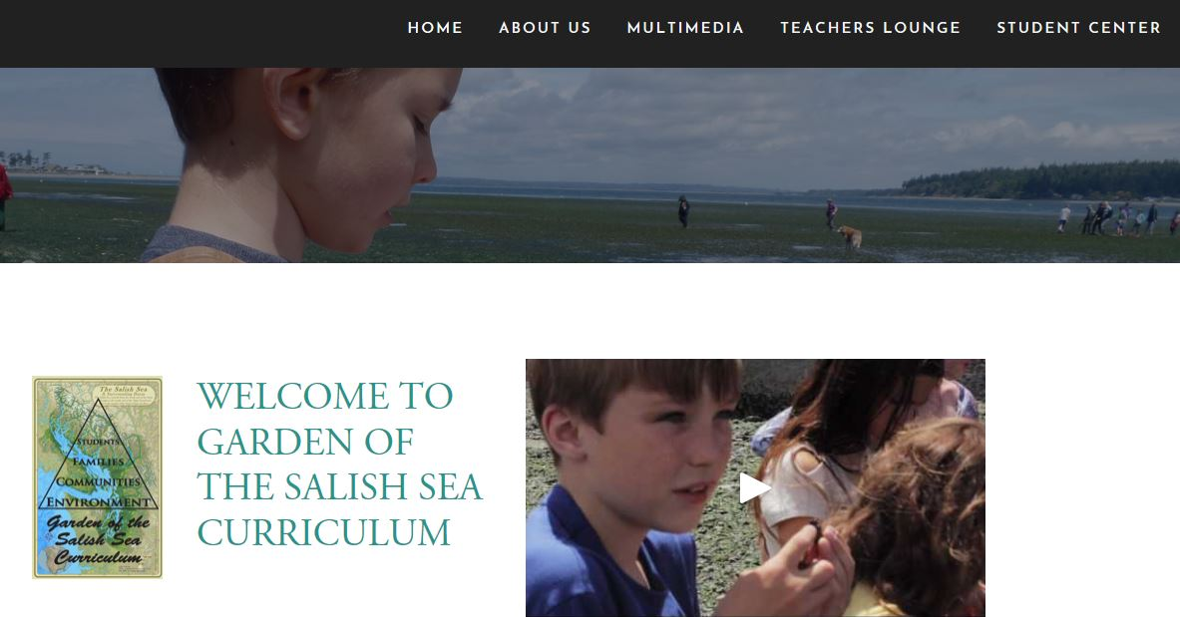

Slide 38
In your notebook:
Why is restoring native shellfish populations considered a priority in the Salish Sea?

